Slide 1

CS 546 – Web Programming I
Fundamentals of Web Development

Slide 2
Patrick Hill
Adjunct Professor Computer Science Department
Patrick.Hill@stevens.edu

Slide 3
What is the Web and How Does it Work?

Slide 4
The Core Process of the Web: HTTP
One of the most commonly used services on the Internet is the World Wide Web (WWW). The application protocol that makes the web work is Hypertext Transfer Protocol or HTTP.
Do not confuse this with the Hypertext Markup Language (HTML). HTML is the language used to write web pages. HTTP is the protocol that clients and web servers use to communicate with each other over the Internet. It is an application level protocol because it sits on top of the TCP layer in the protocol stack and is used by specific applications to talk to one another. In this case the applications are web browsers and web servers.

Slide 5
The Core Process of the Web: HTTP
HTTP is a connectionless text-based protocol. Clients (usually web browsers, but not limited to just web browsers) send requests to web servers for web elements such as web pages, assets and data.
After the request is serviced by a server, the connection between client and server across the Internet is disconnected. A new connection must be made for each request. Most protocols are connection oriented. This means that the two computers communicating with each other keep the connection open over the Internet. HTTP does not however. Before an HTTP request can be made by a client, a new connection must be made to the server.

Slide 6
The Core Process of the Web
At the end of the day, the web is all about the communication of ideas. Everything in the web can be seen as a request and a response
When you go to a news website, you’re requesting news and receiving news in response.
When you go to a shopping website, you’re requesting product information and receiving relevant information.
When your server receives input, it determines what to do with that input and outputs the proper response.
Your duty as a web developer is to make that communication possible. Your programs will get a request and give a response and allow that communication to occur as smoothly as possible.

Slide 7
The Core Process of the Web

Slide 8
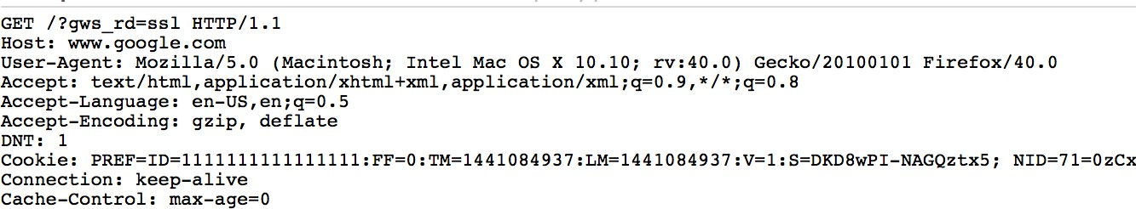
The Request
Every time you navigate to a website, your browser sends a request on your behalf to the server.
There is a lot to an HTTP request! https://developer.mozilla.org/en-US/docs/Web/HTTP
Each request follows a standardized process! https://www.w3.org/wiki/How_does_the_Internet_work
Every request is formatted in a specific way, with the same data provided on each request. A request to http://google.com/ would look like:

Slide 9
Parts of That Request
The HTTP request has a lot of data that is sent including:
HTTP verb signifying what action you are trying to (GET, POST PUT, DELETE).
The protocol.
The server you want to connect to (the HOST).
The User-Agent: Information about the user’s browser, platform etc..
The location of the resource you want to access on that server (the location).
Headers: headers are metadata about your request, these include cookies!.
Request body (if there is one).

Slide 10
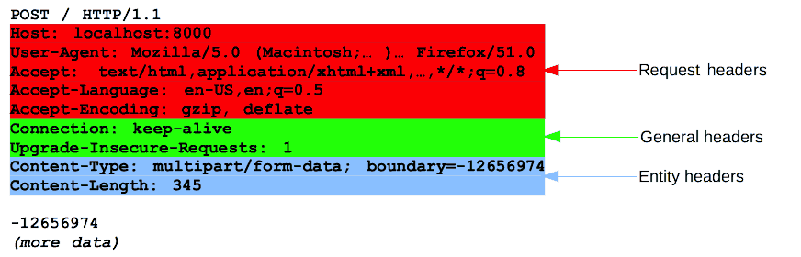
Parts of That Request
GET Request:
POST Request:

Slide 11
What Does the Server Do with That Information?
The server reads that request and determines what needs to be done in order to generate a response that makes sense for the data that the server has been given.
The server uses data sent in the request in order to generate a response. Some common types of data in a request that servers use are:
Querystring parameters
Headers
Cookies
Request body

Slide 12
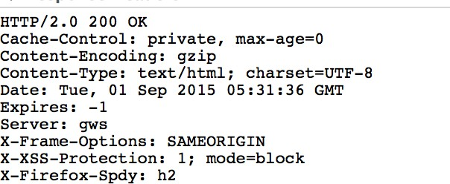
The Response
The server sends back a response that is similar to the request. It contains:
A status code
Indicates whether or not the operation succeeded
A set of headers
Cookies, data about the response such as content type
This is often “meta-data” about the response.
Some form of response body:
An HTML Document
A JSON response
A File Stream
Plain Text
Etc.

Slide 13
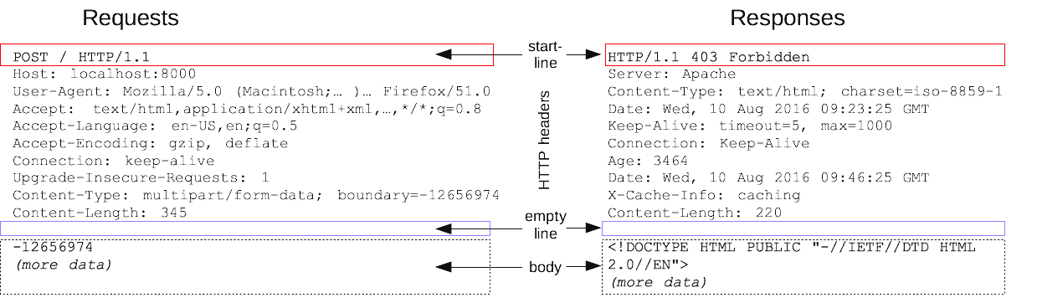
Request/Response Example

Slide 14
Status Codes
Each response must return a status code indicating whether the request was successful, and a description is often included with each of the status code
Status codes in the...
200-299 range indicate a successful operation
300-399 range indicate some sort of redirection must occur
400-499 range indicate an error was made by the client during the request
500-599 range indicate some sort of error occurred on the server
You will use different status codes to describe different errors in this course Some status codes:
https://en.wikipedia.org/wiki/List_of_HTTP_status_codes

Slide 15
The Browser
There are many different browsers, but they each allow for the same fundamental actions to occur:
They allow a user to navigate to a URL
They then submit a request on the user’s behalf to the server at that URL
They receive a response back from the server
They render these responses
They execute any code that they may have received in these responses, for the lifetime of the user being on the web page.

Slide 16
The Browser
When you type a URL into a web browser, this is what happens:
If the URL contains a domain name, the browser first connects to a domain name server and retrieves the corresponding IP address for the web server.
The web browser connects to the web server and sends an HTTP request (via the protocol stack) for the desired web page.
The web server receives the request and checks for the desired page. If the page exists, the web server sends it. If the server cannot find the requested page, it will send an HTTP 404 error message. (404 means 'Page Not Found' as anyone who has surfed the web probably knows.)
The web browser receives the page back and the connection is closed.
The browser then parses through the page and looks for other page elements it needs to complete the web page. These usually include images, stylesheets, scripts, etc.
For each element needed, the browser makes additional connections and HTTP requests to the server for each element.
When the browser has finished loading all images, stylesheets, scripts, etc. the page will be completely loaded in the browser window.

Slide 17
The Browser

Slide 18
More Than Just Web Pages
There is a fundamental idea you must hold onto from now on:
Your server is not a tool to transmit a web page to a user
Your server is a tool to transmit information in response to a request
Web pages are a very small part of the internet. As a web developer:
You will transmit text that represents data in JSON format
You will transmit text that represents an HTML document
You will transmit text that represents an XML document
You will transmit binary data
You will transmit media files
None of these require a browser! You will often write programs that make requests and rely on responses for data!

Slide 19
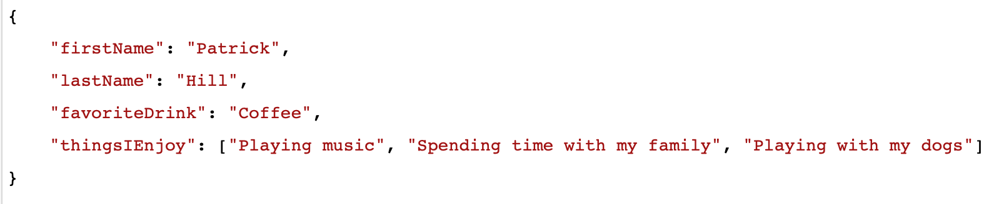
What is JSON?
JSON is JavaScript Object Notation and is probably the most popular way for representing data on the internet.
Many technologies in the modern era can easily communicate with each other by using JSON as a common way of representing data between them.

Slide 20
Running a Node.js Web Server

Slide 21
Express
Express is a very popular node package that is distributed on NPM which allows you to configure and run an entire web server.
http://expressjs.com/
Express allows you to configure different routes and how they should compose a response.
Essentially, by using the Express Node module, you will use code to configure a server that will listen to requests and send out responses.
This is all a web server is! It’s not magic, it’s just something that takes in requests and sends back responses!

Slide 22
What is a Route?
Routing refers to determining how an application responds to a client request to a particular endpoint, which is a URI (or path) and a specific HTTP request method (GET, POST, and so on).
http://expressjs.com/en/starter/basic-routing.html
For your web applications, you will configure many routes that will each perform some action.
By configuring routes, you can have the same URL perform different tasks based on having different request methods (HTTP Verbs)

Slide 23
Request Methods
There are many different types of request methods. For this course, you will be using 5:
GET
The GET method requests a representation of the specified resource. Requests using GET should only retrieve data.
POST
The POST method is used to submit an entity to the specified resource, often causing a change in state or side effects on the server.
PUT
The PUT method replaces all current representations of the target resource with the request payload.
PATCH
Similar to PUT, but you can replace portions of the resource instead of the whole resource.
DELETE
The DELETE method deletes the specified resource.
Other Methods
https://developer.mozilla.org/en-US/docs/Web/HTTP/Methods

Slide 24
GET Requests
Let us use a blog as an example.
GET requests are made when the client is requesting the representation of a resource
Location | Client is requesting… | Server is responding with…
http://myblog.com | The homepage of the blog | An HTML document with the most recent blog posts perhaps
http://myblog.com/post/2 | The blog post with an ID of 2 | An HTML document with the contents of the blog post
http://myblog.com/editor | A page with an editor to write new posts | An HTML document with a form so the user can compose a new blog post
http://myblog.com/post/2.json | A blog post with and ID of 2, but only the raw JSON data of the content | A JSON document representing the content of the blog post

Slide 25
POST Requests
POST requests are made when the client is requesting to create some form of resource.
POST data comes with a message body that describes the content (which usually comes from an HTML form the user filled out, but not always)
Location | Client is requesting… | Server is responding with…
http://myblog.com/post | The data from the form that was filled out in the editor is submitted to this route for processing | An HTML document with the newly created post

Slide 26
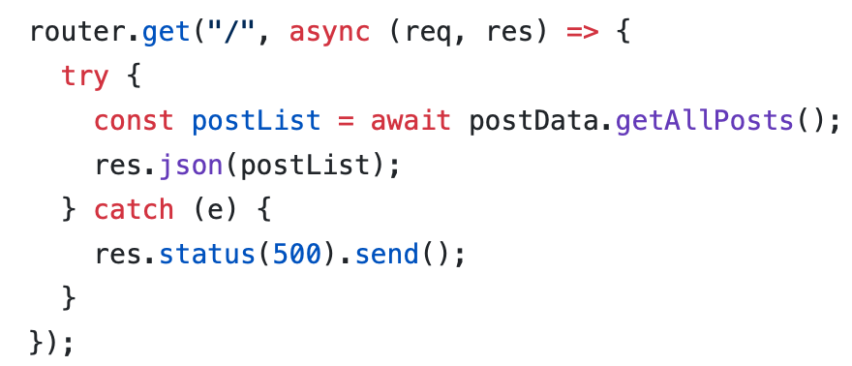
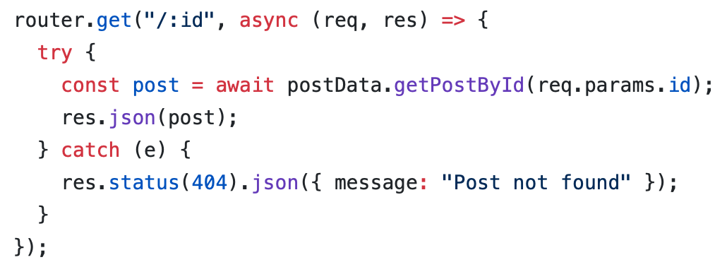
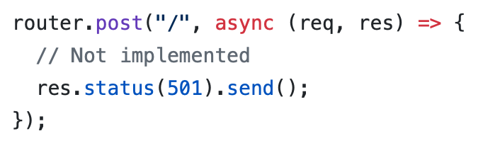
Creating Route Modules
If you open routes/posts.js from this week’s lecture code, you will see a router being created, with three routes setup; one to get a list of all posts, one to create a new post, and one to get a specific post.
A router is a set of rules that dictate how to respond to requests with particular paths and HTTP verbs.

Slide 27
General Organization
When running a server, running npm start should start your server and print a message with its address (including port).
You will have:
A file that creates, configures, and runs your server (app.js)
A folder with all your route modules (./routes)
An index file in the route folder that returns a function that attaches all your routes to your app (./routes/index.js)
Route modules (./routes/posts.js)
A folder for your data access layer modules (./data)
Your connection (./data/mongoConnection.js)
Your collection file (./data/mongoCollection.js)
Your data modules (./data/posts.js)
Potentially, an index file that exports all other data access modules

Slide 28
Express
app.js:
const express = require("express");
const app = express();
const configRoutes = require("./routes");
configRoutes(app);
app.listen(3000, () => {
console.log("We've now got a server!");
console.log("Your routes will be running on http://localhost:3000");
});

Slide 29
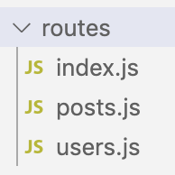
Requiring a Folder
You may require a folder by placing a file called index.js inside the folder.
This is useful for organizing things, such as defining all your routes in a routes folder and all your data modules in a data folder.
const configRoutes = require("./routes"); Here we are requiring the entire routes folder. If we require a whole folder, we need an index.js inside to “glue” the other files together.
const postRoutes = require("./posts");
const userRoutes = require("./users");
const constructorMethod = app => {
app.use("/posts", postRoutes);
app.use("/users", userRoutes);
app.use("*", (req, res) => {
res.status(404).json({ error: "Not found" });
});
};
module.exports = constructorMethod;

Slide 30
Node as an API (GET)

Slide 31
The Purpose
The purpose of our first servers will be simple: to create an API (Application Program Interface)
An API is a way to interact with a program.
We will begin with treating our servers as an access point to run our applications. Our first server will allow us to read some blog posts that will be stored in MongoDB.

Slide 32
Seeding Our Database
“Seeding” a database means adding initial data.
By running npm run seed we can run a task we’ve defined in our package.json file, which will run a script that will seed our database with a single user and a single post.

Slide 33
Requesting Data
There is a great deal of data available in a request! For now, we will be focusing on requests and only be making simple responses.
In our blog, we will be using request parameters
Request parameters are dynamic parameters we define in our route.
You should read up on the API for request data
http://expressjs.com/en/api.html#req

Slide 34
Sending a Response
For now, we will only be using two response methods:
res.json(someData); will send a JSON object as the response with a status code of 200 (unless otherwise specified)
res.status(statusCode).send(); will issue a response with the provided status code

Slide 35
Questions?

